Slide 1
Online complaints management system
Team Members:
Member 1:Veera Kumari Anantha
Member 2:Raja Kumari Chapala
Member 3:Dasari Sahitya Lalitha Sri
Member 4:Komarthi Arun Kumar

Slide 2
INTRODUCTION
Project Overview:
The Complaint Registry System is a web-based full-stack application developed using the MERN stack (MongoDB, Express.js, React.js, and Node.js). It allows users to submit complaints and track their resolution, while enabling administrators to manage, prioritize, and resolve those complaints through an intuitive dashboard.
Purpose:
The goal of this project is to digitalize the complaint handling process, ensuring faster resolutions, better tracking, and increased transparency between users and the authority managing the complaints.

Slide 3
IDEATION PHASE
Problem Statement:
Manual complaint handling leads to inefficiencies, delays, and poor accountability. There is a lack of centralized systems to track complaint status, update users, and maintain history. A digital platform is needed to streamline and standardize this process.
Empathy Map Canvas:
Users feel: Frustrated due to delays and lack of updates.
Users see: No formal complaint follow-up process.
Users hear: "Nothing gets resolved on time.“
Users do: Repeatedly follow up or abandon the complaint.

Slide 4
Pain Points: Lack of transparency and record.
Gain: Structured, trackable complaint resolution system
Brainstorming:
Complaint categorization
Multi-user role access (admin/user)
Email or notification alerts
Anonymous complaint option
Mobile support

Slide 5
REQUIREMENT ANALYSIS
Customer Journey Map:
User signs up or logs in.
Submits a complaint using the provided form.
Admin receives the complaint in their dashboard.
User views status updates in real time
Solution Requirement
Functional Requirements:
User registration/login
Complaint submission & viewing
Non-Functional Requirements:
Secure login system
Responsive interface

Slide 6
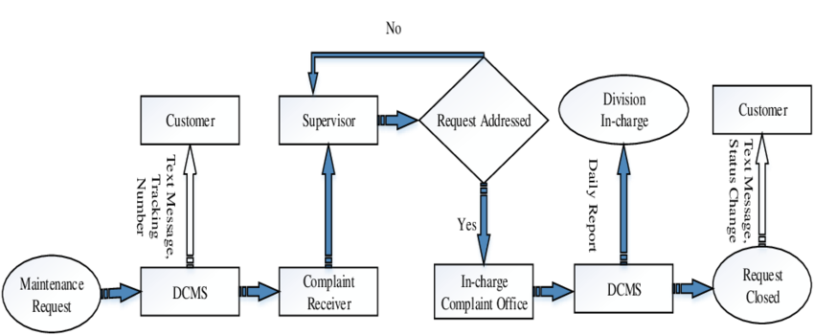
Data Flow Diagram

Slide 7
Technology Stack:
Frontend: React.js, Bootstrap
Backend: Node.js, Express.js
Database: MongoDB with Mongoose
Others: bcrypt (security), Postman (testing), Git (version control)
PROJECT DESIGN
Problem-Solution Fit:
Digitizing complaint handling ensures all complaints are logged, managed, and tracked transparently. This eliminates manual delays and improves resolution efficiency.

Slide 8
Proposed Solution
A responsive web portal with user and admin modules:
Users can file and view complaints.
Admins can view all complaints, change their status, and close them.
Architecture:
Authentication via JWT/session
CRUD APIs for complaint management
Separate admin and user logic

Slide 9
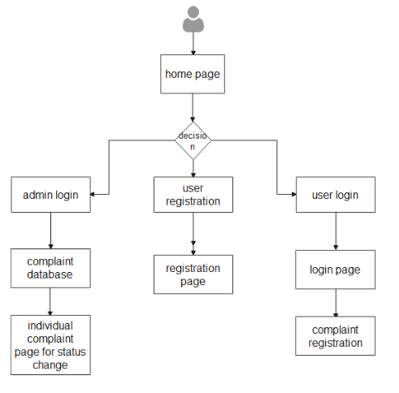
Solution Architecture

Slide 10
PROJECT PLANNING & SCHEDULING
Project Planning
Week | Activities
1 | Requirement Gathering, UI/UX Planning
2 | Frontend Setup with React
3 | Backend Setup with Node & Express
4 | MongoDB Integration & Complaint Model
5 | Authentication & Admin Panel
6 | Testing, Deployment, and Documentation

Slide 11
FUNCTIONAL AND PERFORMANCE TESTING
Performance Testing:
Backend API tested with Postman and load testing tools.
Frontend rendering tested for responsiveness and speed.
MongoDB queries optimized for fast data retrieval.
ADVANTAGES :
Easy to use and maintain
Real-time status updates
Admin-user communication
DISADVANTAGES:
No mobile app version
Limited access control (admin vs user only)
Internet required to use system

Slide 12
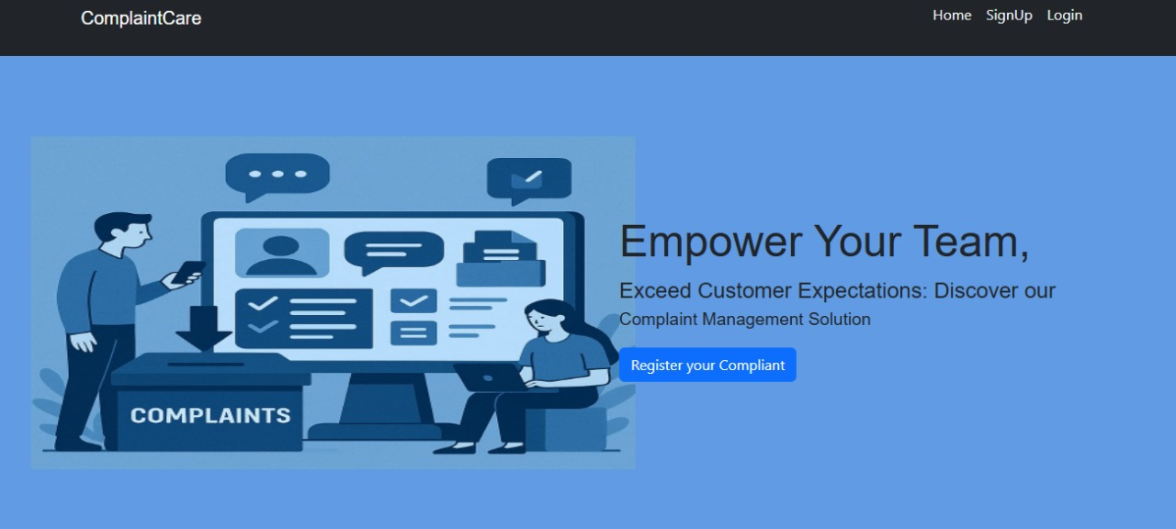
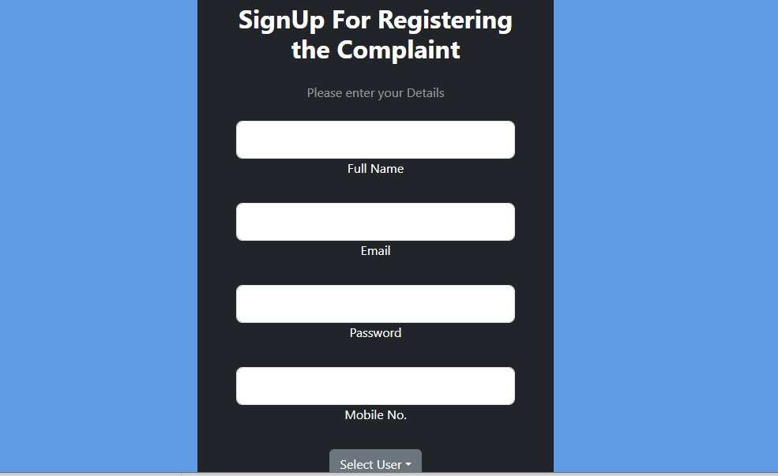
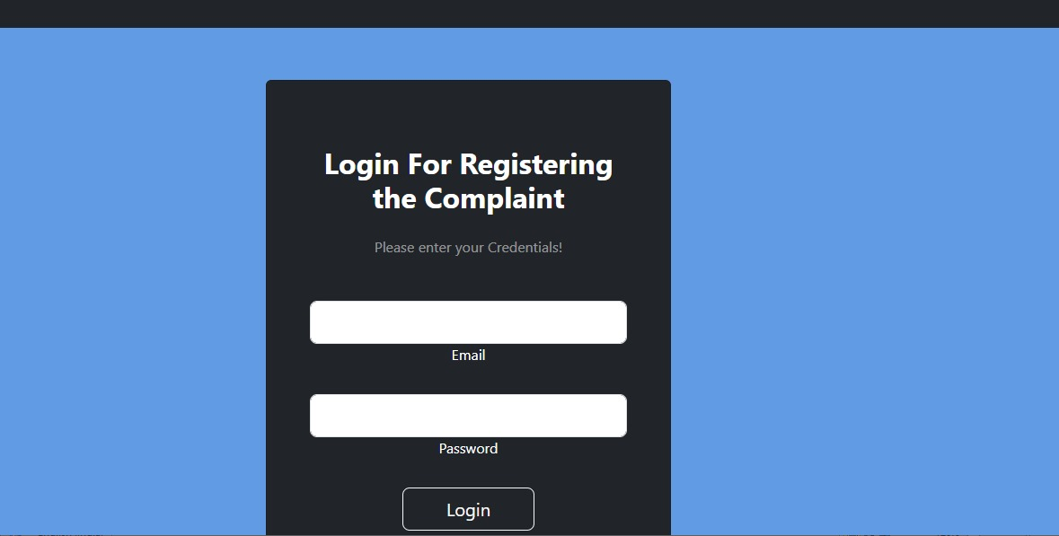
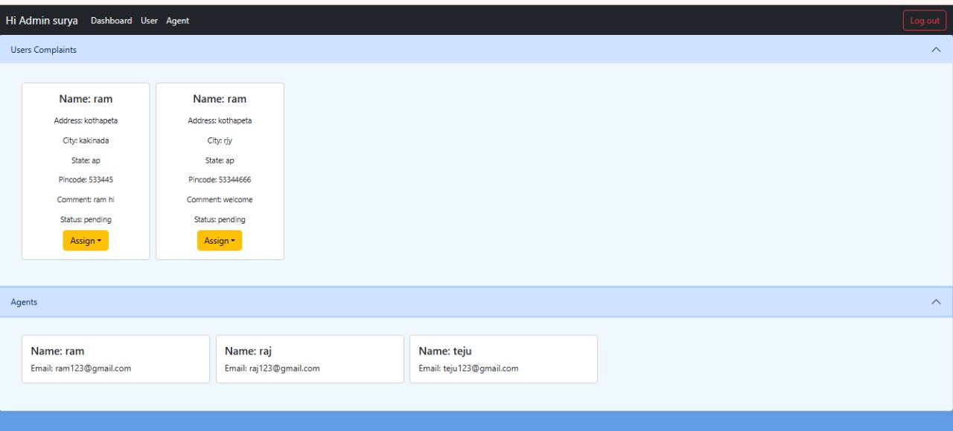
RESULTS

Slide 13
CONCLUSION
The Complaint Registry System effectively addresses issues in manual complaint handling by providing a digital solution that is organized, trackable, and efficient. It improves transparency, speeds up resolution, and increases trust between users and administrators.
FUTURE SCOPE:
Develop a mobile application
Add notification features (Email/SMS)
Enable role-based access (moderators, super-admins)
Integrate AI for complaint classification and priority handling

Slide 14
APPENDIX
Source Code:
Dataset Link:
GitHub Link:
Live Demo Link:

